Slide 1

Mini Project-II (ID201B) EVEN Semester Session 2024-25
DSA TRAINER
Aman Kumar 202410116100020
Alok Kumar 202410116100018
Anand Patel 202410116100023
Ambikeshwar Dutt Dwivedi 202410116100022
Project Supervisor:
Dr. Vipin Kumar

Slide 2
Content
Introduction (1 slide)
Literature Review (2 slides)
Objective of the Project (1 slide)
Technology
Hardware Requirements (Development Environment, Server requirement (if required), Client requirement (if required).
Software Requirements (Language and Platforms like Frameworks, VS code, Android Studio and Jupyter notebook etc. )
Modules (3 slides)
Workflow (1 slide)
Reports (For Example: Project : Student Monitoring System, so reports like: Student Marks, Subjects, companies visit, and student appears in placement etc.)
References (1 slide)
Notes:
Font Styles: Times New Roman + Font Size: 25

Slide 3
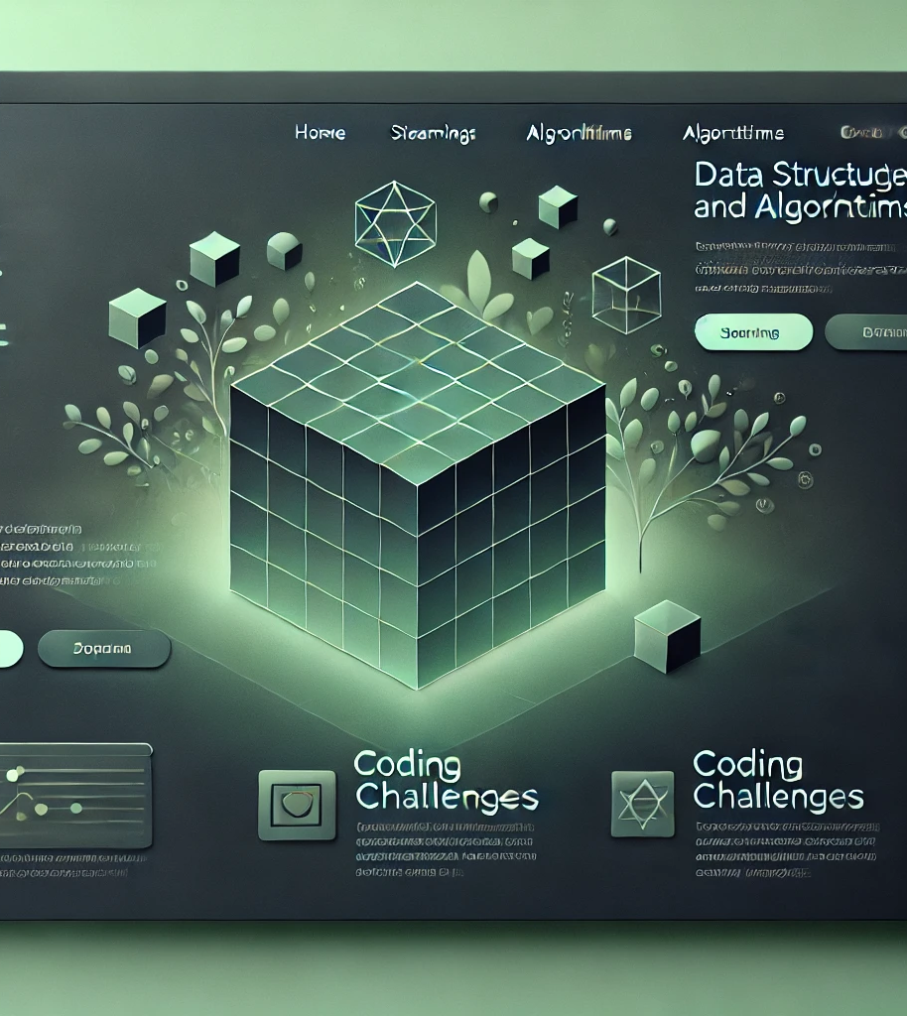
Introduction
DSA Trainer is an interactive learning platform designed to help students and professionals master Data Structures and Algorithms (DSA).
Purpose:
Provide structured DSA learning with real-world problem-solving examples.
Enable discussions and collaborative problem-solving among users.
Provide hands-on coding challenges to reinforce learning.
Target Audience: Students, developers, and coding enthusiasts looking to improve their DSA skills.
Notes:
Font Styles: Times New Roman + Font Size: 25

Slide 4
Literature Review
.
IMPORTANCE OF DSA
What is DSA? A fundamental skill for programming, data manipulation, and optimizing software solutions.
Why is it important?
Essential for problem-solving, competitive coding, and technical interviews.
Forms the backbone of computer science and software engineering.
Current Learning Platforms: LeetCode, CodeChef, HackerRank, GeeksforGeeks.
Challenges Faced by Learners:
Lack of structured guidance for beginners.
Too many problems without clear direction.
No proper guidance for short-time learning.
Difficulty in covering all topics efficiently.
Notes:
Font Styles: Times New Roman + Font Size: 25

Slide 5
Literature Review (Contd.)
Gaps in Existing Solutions
Lack of a structured roadmap for beginners.
No clear guidance for short-term learning and quick topic coverage.
Limited interactive and collaborative learning opportunities.
Overwhelming number of problems without a defined learning path.
Insufficient real-world problem-solving examples.
Notes:
Font Styles: Times New Roman + Font Size: 25

Slide 6
Objective of the Project
Primary Objectives:
Develop an interactive learning experience for mastering DSA.
Implement a discussion forum to facilitate peer-to-peer learning.
Create a user-friendly admin panel for content moderation and management.
Enable seamless data insertion and updates for scalability.
Notes:
Font Styles: Times New Roman + Font Size: 25

Slide 7

Technology Stack
Backend: Node.js, Express
Frontend: HTML, CSS, JavaScript.
Database: MySQL
Hosting & Deployment: Azure.
Version Control: GitHub.

Slide 8
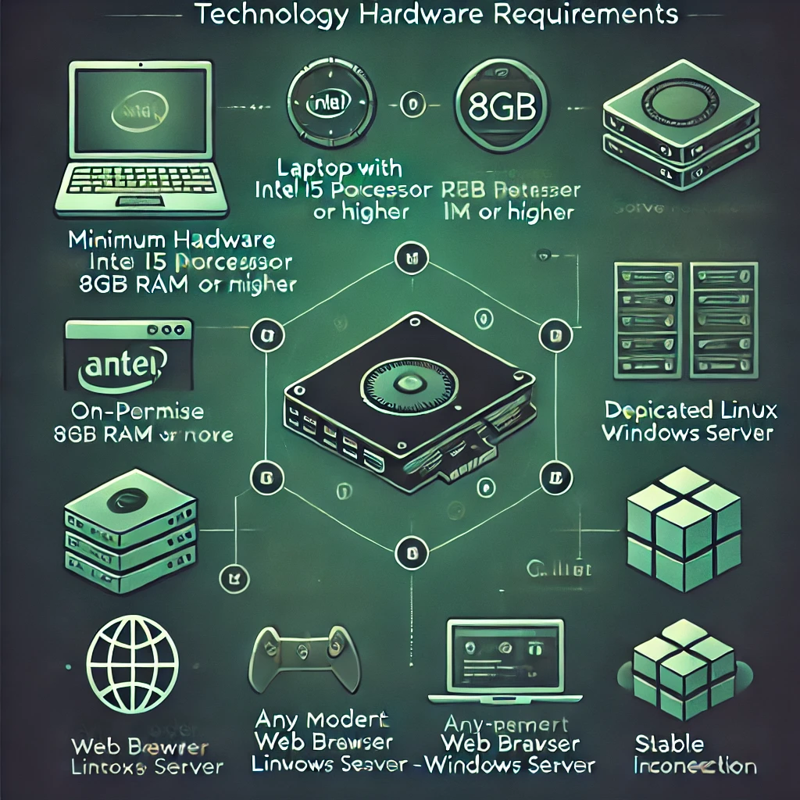
Technology (Hardware Requirements)
Development Environment
Laptop with Intel i5 or higher, 8GB+ RAM (SSD recommended).
Server Requirements (if applicable)
Cloud-based: Azure, AWS, Digital Ocean.
On-premise: Dedicated Linux/Windows Server.
Client Requirements:
Any modern web browser (Chrome, Firefox, Edge, Safari).
Stable internet connection for accessing the platform.
Notes:
Font Styles: Times New Roman + Font Size: 25

Slide 9
Technology (Software Requirements)
Web Development Tools:
Text Editor/IDE: Visual Studio Code, Sublime Text, or any preferred code editor
Version Control: Git for version control and collaboration (GitHub or GitLab).
Database:
MySQL (SQL) for data storage and management.
Web Browser:
Latest version of Google Chrome, Firefox, or Safari for testing and running the application
Notes:
Font Styles: Times New Roman + Font Size: 25

Slide 10
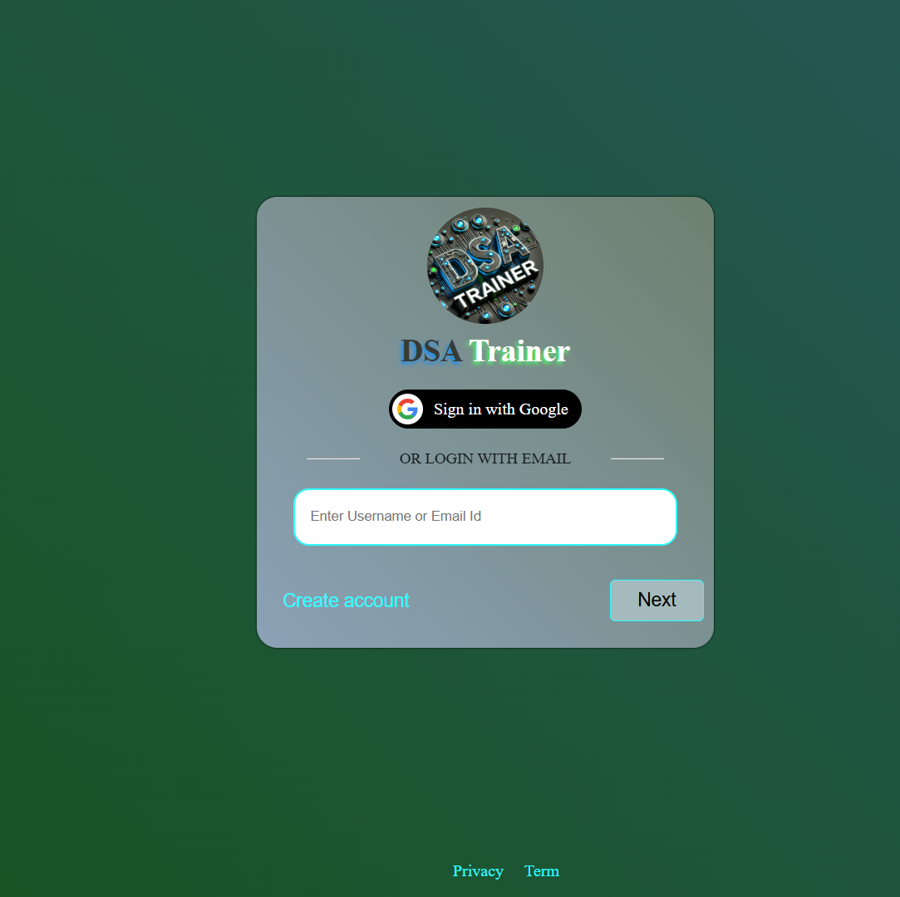
Module 1
Login Module
Features:
User authentication (signup, login, logout, password reset).
Role-based access (Admin/User) with secured authorization.
Notes:
Font Styles: Times New Roman + Font Size: 25

Slide 11

Module 2
Admin Panel Module
Features:
Manage users and permissions.
Monitor discussions and moderate content to maintain quality.
Insert and update DSA learning materials efficiently.
Notes:
Font Styles: Times New Roman + Font Size: 25

Slide 12

Module 3
User Interface & Discussion Module
Features:
Interactive UI with structured DSA topics.
Comment and discussion section for collaborative learning and problem-solving.
Real-time notifications for replies and discussions.
Upvote and bookmark options for important discussions.
Notes:
Font Styles: Times New Roman + Font Size: 25

Slide 13
Workflow/Gantt Chart
Phase | Timeline | Tasks
Phase 1 | Week 1 | Requirement Analysis & UI/UX Design
Phase 2 | Week 2-3 | Backend & Frontend Development
Phase 3 | Week 4-5 | Testing & Bug Fixing
Phase 4 | Week 6 | Deployment & Feedback Collection
Notes:
Font Styles: Times New Roman + Font Size: 25

Slide 14
Reports
This report provides an overview of the DSA Trainer platform, highlighting its purpose, features, technology stack, and impact. It covers:
The need for a structured DSA learning platform.
Challenges faced by learners and existing gaps.
Key features, including an interactive UI, discussion forums, and learning modules.
Implementation details, including backend, frontend, and deployment strategies.
Future enhancements and scalability plans.
This report aims to demonstrate how DSA Trainer effectively bridges the gap in DSA learning and enhances the user experience.
Notes:
Font Styles: Times New Roman + Font Size: 25

Slide 15
References
Official documentation of Node.js, Express, MySQL, and Azure for backend, database, and deployment.
UI/UX design principles from Google Material Design and Bootstrap.
Learning platform methodologies from LeetCode, CodeChef, HackerRank, and GeeksforGeeks.
Research papers and articles on effective DSA learning strategies.
Online resources, blogs, and tutorials for best practices in web development.
Notes:
Font Styles: Times New Roman + Font Size: 25

